Slide 1
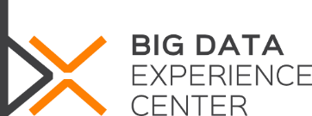
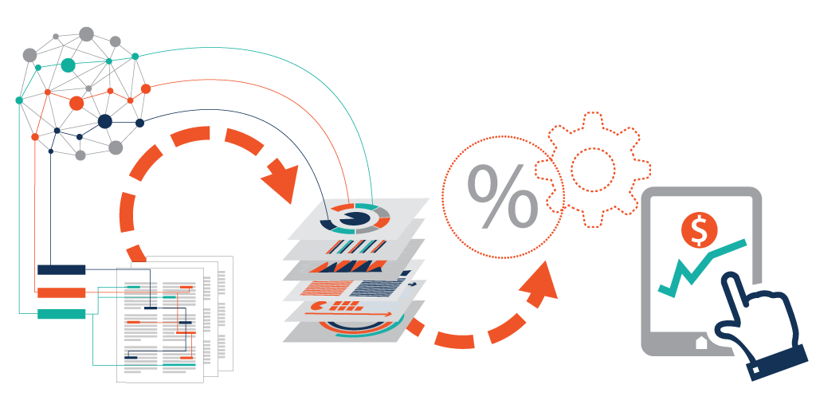

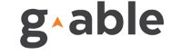
Big Data Analytics
How data fuel the world
By Assoc. Prof. Dr. Tiranee Achalakul
Director, Big Data Experience Center

Slide 2
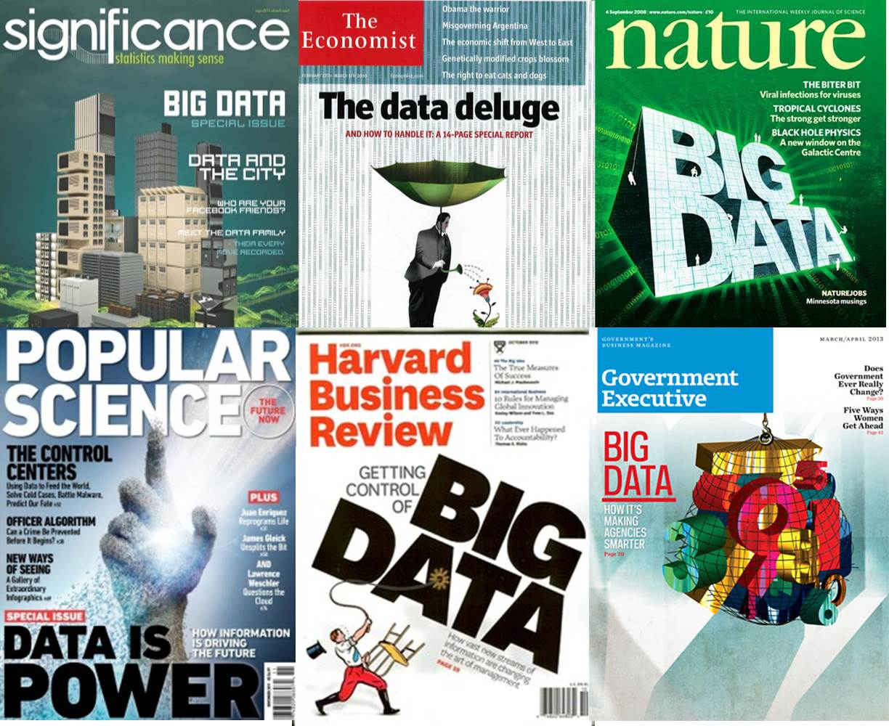

Slide 3
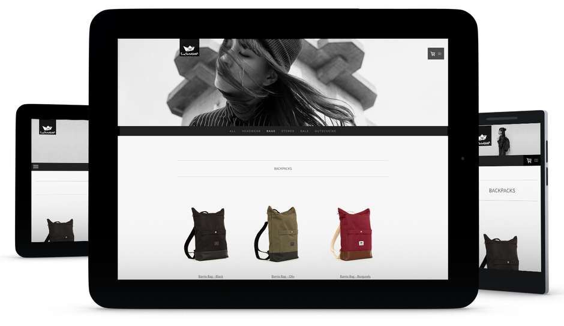
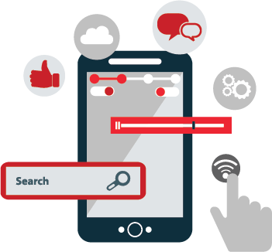
BUYING ONLINE
Customer 360
Knowing your desires, preferences, and opinions
Notes:
Let’s first look at how the technology change who we shop

Slide 4
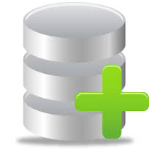




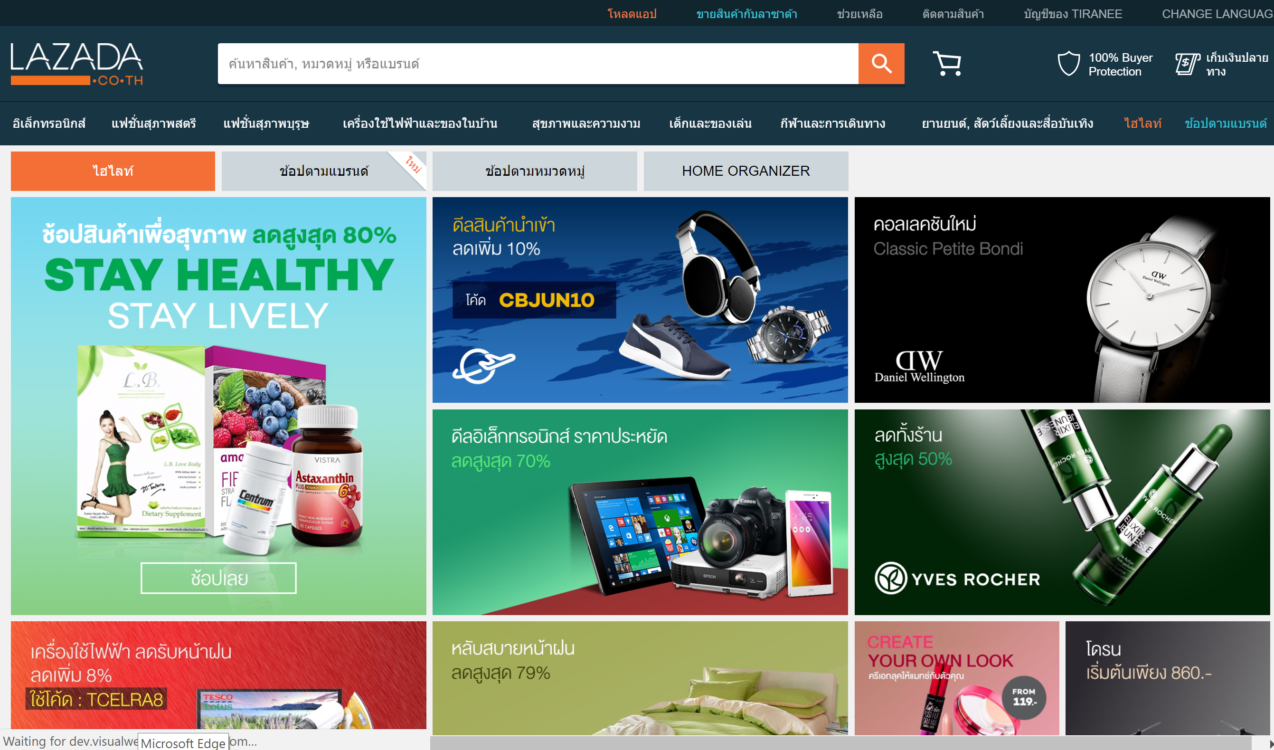
BUYING ONLINE
Paid
Call Center
Enrolled Customer
Ask question
Prospective Customer
Online Store
Cart

Slide 5
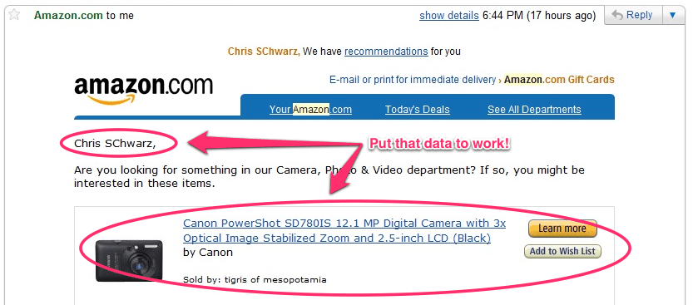
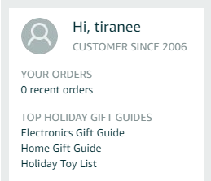
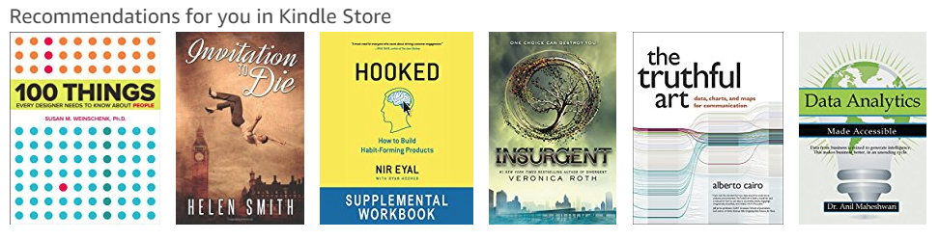
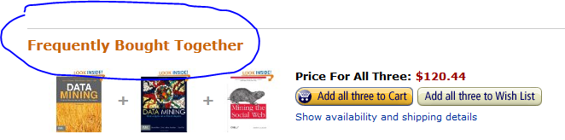
Tiranee Achalakul, We have recommendations for you
Tiranee Achalakul,
Perfect the art of cross-selling
Notes:
Heavily customize the customer browsing experience and perfect the art of cross-selling.
As customer preferences change, organizations are under the gun to develop simpler and more transparent products. Companies can analyze Big Data to better predict customer behavior so they can improve customer retention and become more profitable
Customer behavior analysis: the key to marketing in this digital era is contacting customers just
When they wish to be reached
When they are in the right location
Then, engaging them with personalized real-time offers.

Slide 6
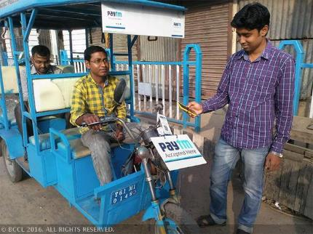
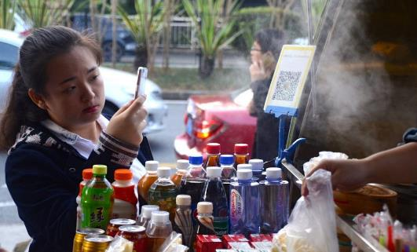
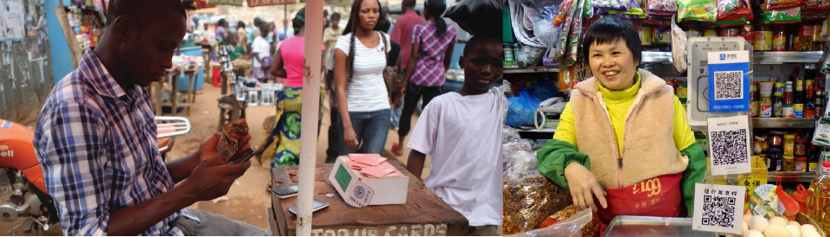
BUYING STREET FOOD
Alipay O2O used by roughly 5% or the world population
Notes:
And don’t forget tenpay (china)
Do a search on payment gateway in india
the code can contain payment information that can be scanned by consumers'
The QR code can represent a pre-paid, credit or debit account number via a smartphone application
---------------------------------------------------------------------------------------------
Barcodes with payment information that can be scanned by consumers
Barcodes to load-up your mobile wallet
Barcodes to engage in e-commerce / regular commerce
Mobile as barcode readers for payments
Barcodes on invoices for bill payments
The QR code can represent a pre-paid, credit or debit account number via a smartphone application, or the code can contain payment information that can be scanned by consumers' smartphones. Alternatively, barcodes can be generated to be scanned at check-out with pre-customized orders.
Barcodes with payment card information via mobile apps
Barcodes to load-up your mobile wallet or engage in e-commerce / regular commerce
Mobile as barcode readers for payments
Barcodes on invoices for bill payments
Ref:
https://www.gsma.com/mobilefordevelopment/programme/mobile-money/the-use-of-barcodes-in-mobile-payments-scanning-the-possibilities

Slide 7
BUYING INSURANCE
Heart rate, blood pressure, blood sugar, weight, and etc.
Nutrition tracking (refrigerator connected)
Fitness Social Network
Personalized, value-added
insurance packages
Premuims based on
fitness habits
Regular exam/consulations
based on past data
Notes:
MetLife, are developing ways to use IoTs to gather data on health-related behavior
Store all data on the cloud
And.. Use analytics to help design their rate and offerings.
Work with Fitbit for physical activities
emerging systems that monitor heart rate, blood pressure, blood sugar, weight
nutrition tracking devices (set up to receive automated signals from the refrigerator and restaurants).
Data from fitness oriented social network
insurance company can build and package value-added services personalized to each individual.
-------------------------------------------------------------------------------------------------------
Not want to create their own version of the quantified self.
Instead, will work with services that already exist: the Fitbit, which measures physical activity; emerging systems that monitor heart rate, blood pressure, blood sugar, weight, and other health-related metrics; and nutrition tracking devices (set up to receive automated signals from the refrigerator and restaurants).
Data combined with those from additional apps and services such as Strava’s fitness-oriented social network.
insurance company can build and package value-added services personalized to each individual.
A health insurer already keeps comprehensive data on its customers’ health status and
past medical treatments and expenses.
It could augment that with individual electronic health records—with customers’ permission, of course.
It could then combine that information with its own actuarial data, supplemented with data from drug
companies, market research firms, school lunch programs, and the government.
It could offer health insurance with coverage tailored to individuals’ needs, and premiums based on their fitness habits.
Customers might receive regular health and nutrition status updates tagged to their individual medical needs, along with reminders for scheduling regular exams and remote consultations that take advantage of their past data.

Slide 8
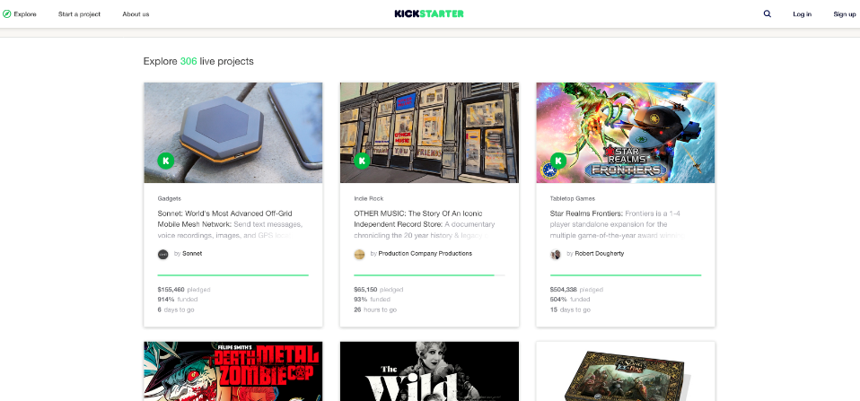
STARTING A BUSINESS
Crowd Funding via Kickstarter
Star Citizen (VDO game)
Asked for 550,000 USD
Raised 90,009,649 USD
Notes:
People can start business without bank loan (no need to have collateral, just have good ideas)
A cloud that is full of great ideas. Cloud-based data value creation
Product trend analysis : access interests in all product categories
Easier move into peer-to-peer loan

Slide 9
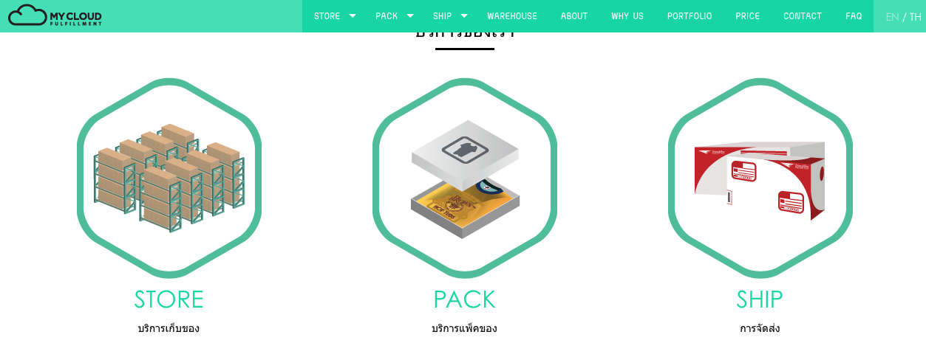

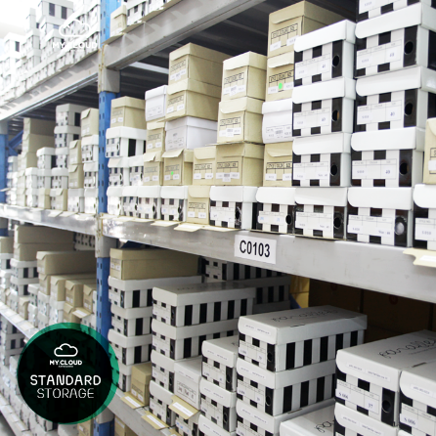
RUNNING A BUSINESS
Multi sales channel
Notes:
One-stop supply chain management solution for e-commerce and omni-channel businesses.
Order fulfillment service provides storing, packing, shipping service for your shops.
Professionals provide help to manage multi sales channel with multi procedures

Slide 10
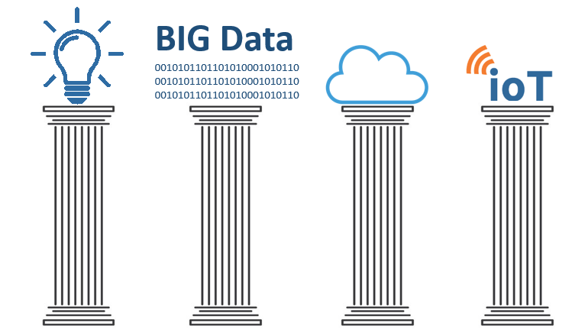

Technologies that change our way of lives
Notes:
Technology can change the world
With technology, We can now gather data that reflect on Behavior, preference, and opinion.
The results; services are designed to fit needs that we don’t know we have.

Slide 11
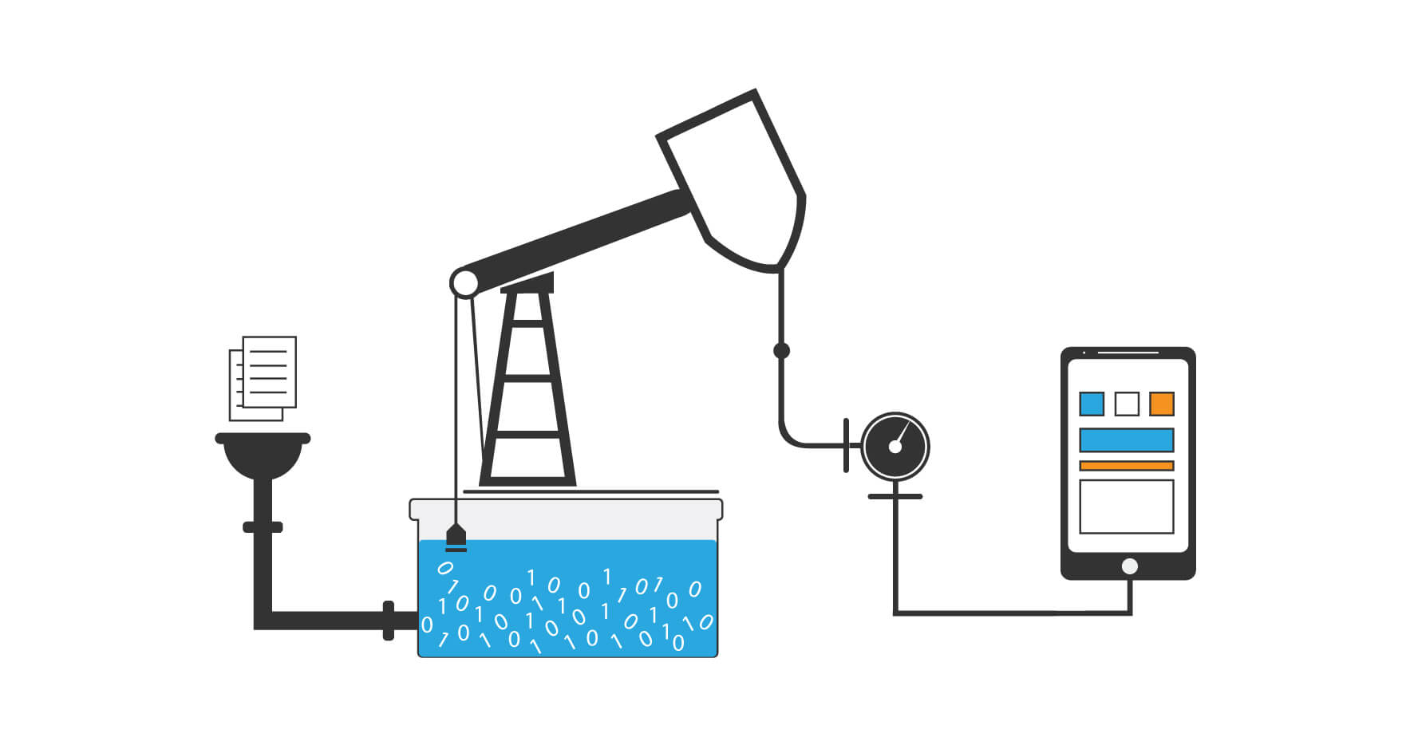
DATA IS THE NEW OIL
The rapid development of technology led to the explosive growth of data in almost every industry and business area.
Data of great
Volume, Variety, and Velocity
Notes:
We used to have ”the Internet” that is basically a network of computers and mobile devices to access digital contents and services.
Now, it has evolved to a network of devices of all types and sizes,
vehicles, home applications, toys, cameras, medical instruments, industrial systems, all connected, and all communicating and sharing information all the time.
IoT is about
- interaction among things, people, and environments
- Data opens to innovation (GIS, weather forecasting, etc.)

Slide 12
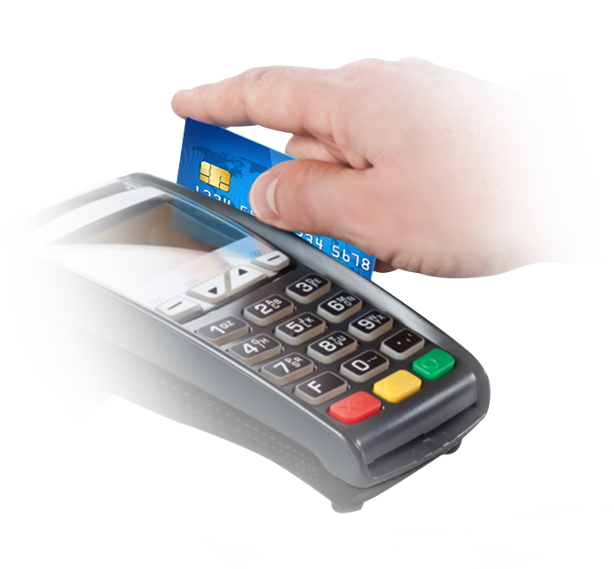
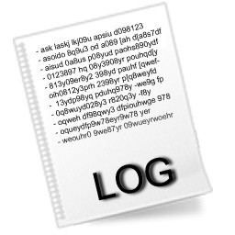
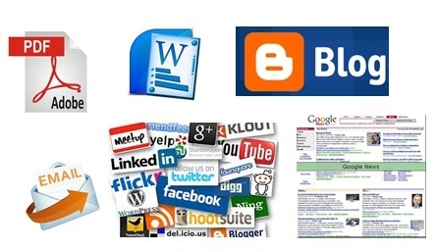
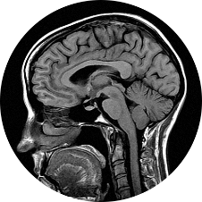
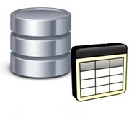
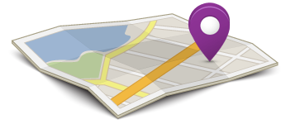
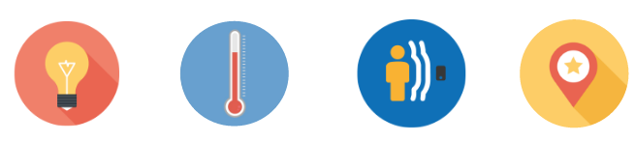
MORE THAN JUST TABLES …
Structured
Unstructured

Slide 13
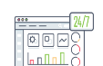

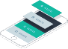










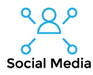

Descriptive Analytics
Predictive Analytics
What happened; How many; how often; where
Project what will happen; possible outcome indication
Business Intelligence Tools (BI)
Developer Environment
Data
Warehouse
Data Lake
Extract, Transform & Load (ETL)
File Copy
Acct
Sales
Supply
CRM
HR
etc.

Slide 14
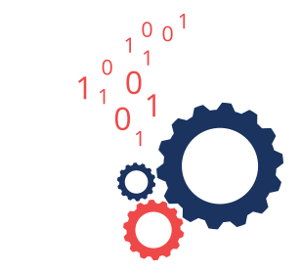
BIG DATA ANALYTICS
A set of fundamental concepts/principles that underlie techniques for extracting useful knowledge from large datasets containing a variety of data types. To uncover hidden patterns, unknown correlations, market trends, customer preferences, and other useful business information

Slide 15

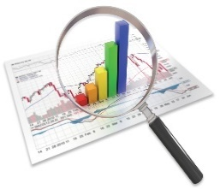
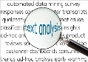


THE ANALLYTICS
Data Mining
The Computational process of discovering patterns in large data sets involving methods at the intersection of statistics, machine learning, and database systems.
Text Analytics
The process of deriving high-quality information from text. High-quality information is typically derived through the devising of patterns and trends through means such as statistical pattern learning.
Machine Learning / Deep Learning
The science of getting computers to learn from data without having to be explicitly programmed by humans. Machine model can teach themselves to grow and change when exposed to new data.
Big Data Technology
Technology designed to manage and process extremely large data sets that may be analyzed computationally to reveal patterns, trends, and associations, especially relating to human behavior and interactions.

Slide 16
EXAMPLE TASKS
Clustering group individuals in a population by their similarity (not driven by any specific purpose).
Do our customers form natural groups or segments?
Co-occurrence grouping find associations between entities based on transactions involving them.
What items are commonly purchased together?
Profiling characterize the typical behavior of an individual, group, or population.
What is the typical cell phone usage of this customer segment ?
Used to establish behavior norms for anomaly detection (fraud detection)

Slide 17



THE ANALYTICS
Big decisions need better analytics
Data science provides fact-based, math-based decision support (Data-Driven Decision)
Descriptive Analytics
tell you what happened; how many; how often; where critical events occur.
Predictive Analytics
project what will happen next; provide indications of possible outcomes if trends continue.
Prescriptive Analytics
Synthesizes big data to make predictions and then suggests decision options to take advantage of the predictions
1
2
3
Notes:
Harness the vast amount of structured and unstructured data from
Sensors (wearable devices, field sensors)
Third-party data sources
Online social media
Internal data warehouse

Slide 18
THE PROCESS
Business Question
Data Aggregation
Data Selection, cleaning and filtering
Insight Derivation
Exploratory Analysis
Model Feasibility
Model Construction
Prediction
Validation
Deployment

Slide 19


MACHINE LEARNING Learn from data and make predictions about data by using statistics to develop self learning algorithm
Notes:
Hanson Robotics: Sofia is a service robots that is designed to care for the elderly, assist people with disabilities to perform daily functions, help children with special needs to learn and even do jobs deemed too dangerous for humans.

Slide 20
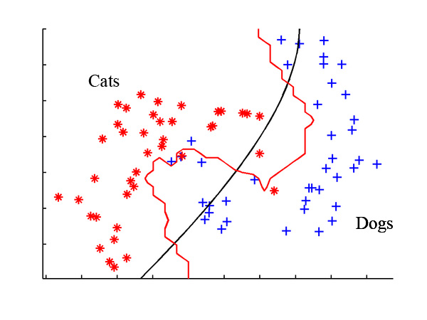
MACHINE LEARNING
Machine Learning
“The science of getting computers to learn from data without having to be explicitly programmed by humans.”
Machine learning is surrounding you
Google search
Auto Facebook photo tagging
Email Spamming
Games
Chat bot
Recommender

Slide 21


Slide 22
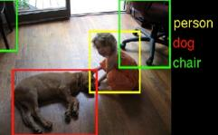


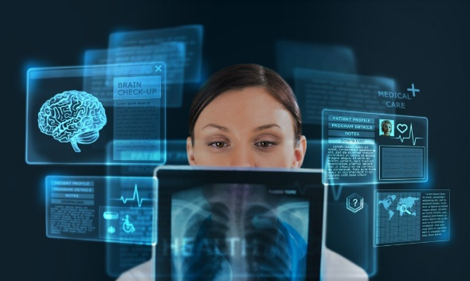
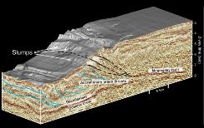
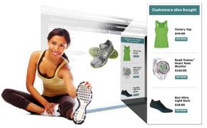
EARLY USE CASES
Image Classification, Object Detection, Localization
Speech & Natural Language Processing
Face Recognition
CHAT BOT
Medical Imaging & Interpretation
Seismic Imaging & Interpretation
Recommender
Systems

Slide 23

ANSWERING BUSINESS QUESTIONS
Who are the most profitable customers?
A straightforward database query, if “profitable” can be defined clearly.
Is there really a difference between the profitable customers and the average customer?
Statistical Hypothesis testing
But who really are these customers? Can I characterize them?
Automated pattern finding
Will some new customer be profitable ? How much revenue can I expect?
Predictive model of profitability

Slide 24
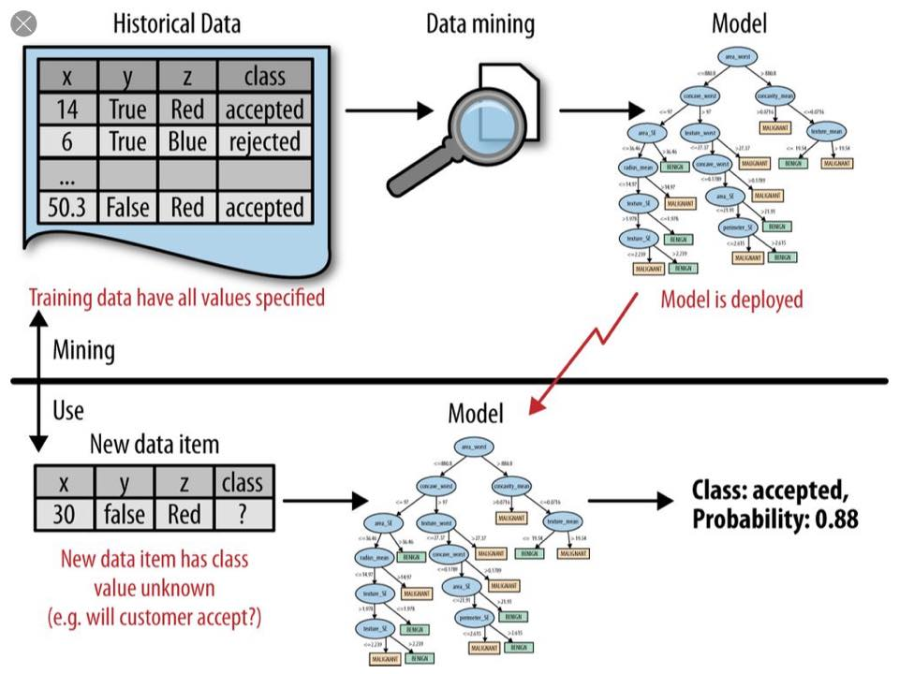

Slide 25
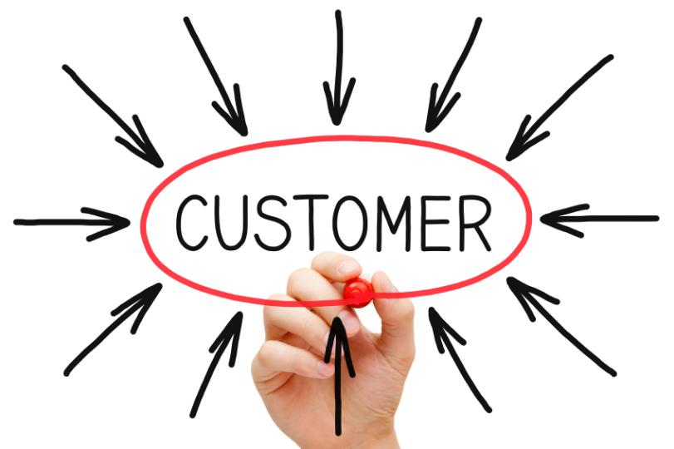
CUSTOMER INSIGHTS
As customer preferences change, organizations are under the gun to develop simpler and more transparent products. Companies can analyze Big Data to better predict customer behavior so they can improve customer retention and become more profitable
Notes:
CLV

Slide 26
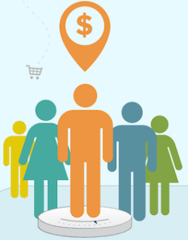
PREDICT CUSTOMER LIFETIME VALUES (CLV)
This measure provides many opportunities to optimize marketing …
Preserve specials for high-value customers
Design marketing campaigns to attract more high-value customers.
Pick acquisition channels that yield highest value customers.
Create campaign that appeal to the highest value customers.
Convert medium-value customers to high-value.
Notes:
Predict customer personas and develop targeted marketing strategy

Slide 27
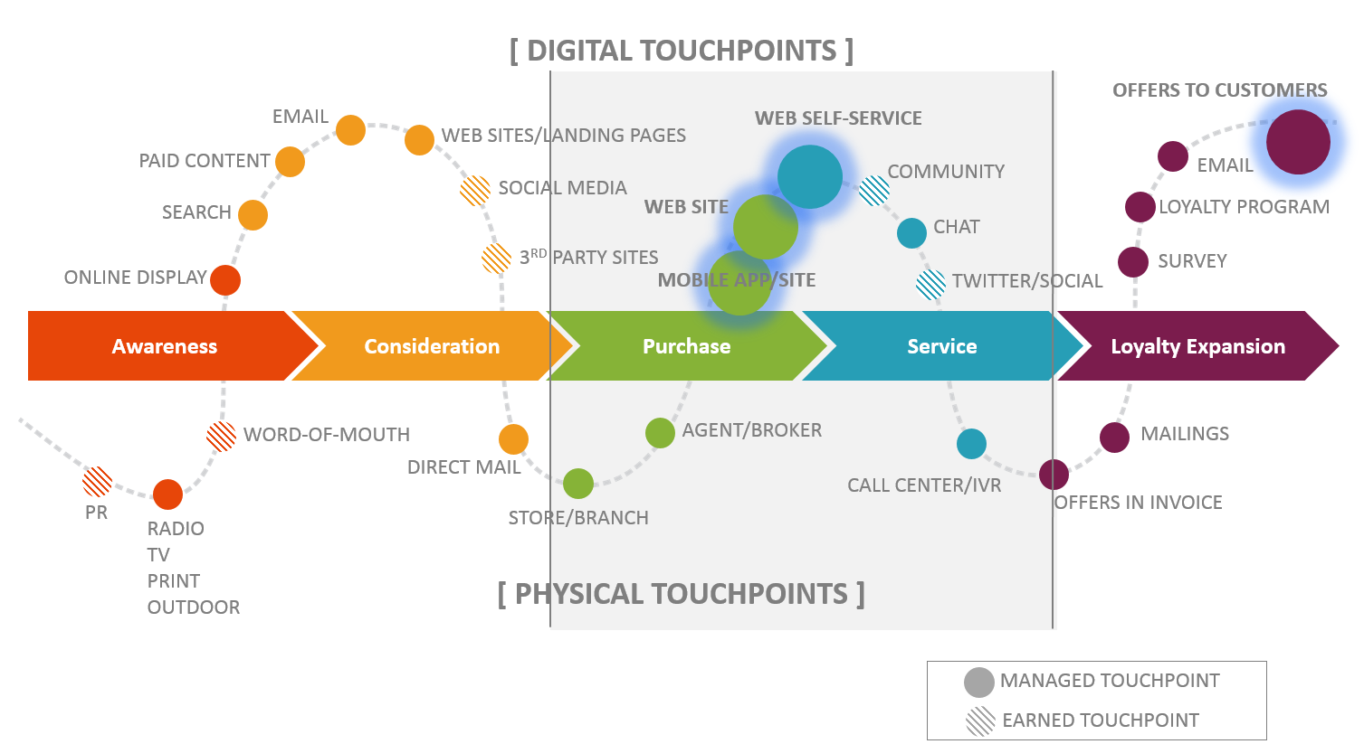
CUSTOMER TOUCHPOINTS
Digital marketing-Mckinsey

Slide 28

Recommendation system (Brought 30% more business)
Data: Shopping cart, wish list, previous purchases, items rated and reviewed, geo-location, time-on-site, duration of views, links clicked, telephone inquiries, responses to marketing materials
Heavily customize the customer browsing experience and perfect the art of cross-selling.
Anticipatory package shipping
Predicting customer orders and ship goods to geographical locations without specific address.

Slide 29

Apply analytical skills to help the store enhance revenues, forecast trends, improve process and much more.
Target identified about 25 products that, when analyzed together, suggested shoppers’ pregnancy.
Target can also estimate the due date to within a small window from purchasing behaviors.
A teenage girl in Minnesota, was pregnant (without her father knowing), based on a formula involving
Elevated rates of buying unscented lotion
Mineral supplements, and cotton balls.
Target started sending her coupons for baby gear

Slide 30




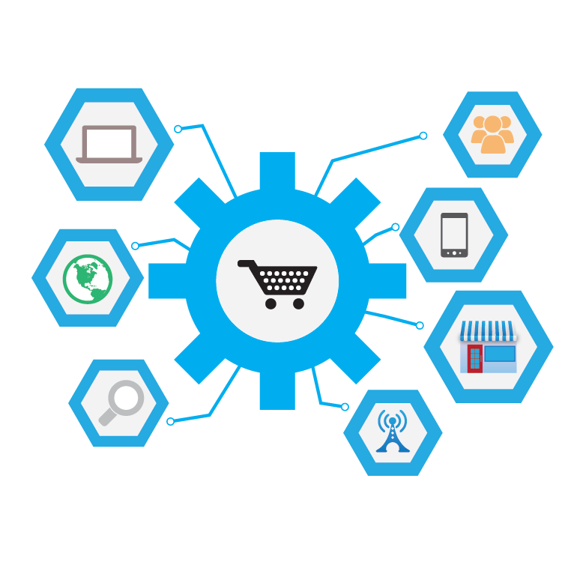
BIG DATA AND MARKETING
Targeted market
Campaign combinations
for effective up-selling
Recommendations
for cross-selling
Predicting
customer
churn
Customer behavior analysis: the key to marketing in this digital era is contacting customers just
When they wish to be reached
When they are in the right location
Then, engaging them with personalized real-time offers.
Notes:
Clustering
Co-occurrence grouping
Customer profiling

Slide 31
NEEDS OF SMEs
Product recommender and Market basket analysis based on purchase transaction data
Find the customer preferences
Find the association between products
Recommend the products that each customer most likely prefers
Digital Marketing Platform for customer targeting and Cheaper Ad posting
Find new customers
Target existing customers for a particular promotion campaign
Search engine optimization
Ad booking
Visualize purchase order data in several perspectives to support business intelligence.
Notes:
Jebsons and Jebsons
ทาสแมว

Slide 32
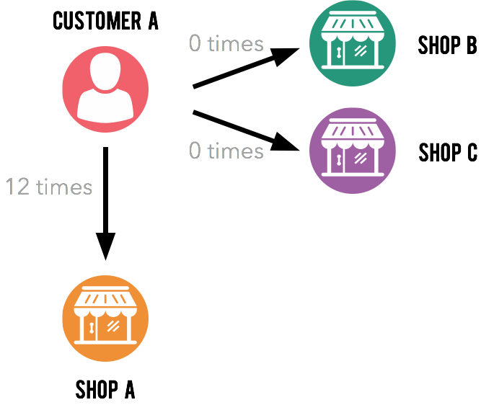
RECOMMENDER ENGINE FOR CREDIT CARD USERS
Predictive Marketing Analytics
Predict shop preference from previous behaviors.
Swipe time prediction.
Win back inactive customers by predicting deal preference from demographics.
Will customer A like shop B and shop C?
Notes:
A leading bank in Thailand has over 2 million customers, processing 200k transactions per day.
They know shoppers behaviors, who go to what shop, but they cannot know a customer’s preference for the shops that customer has not been to. How do you predict?
So that you can send marketing message that surprises and delights, and deliver the right deal to the right person at the right time
We use several types of collaborative filtering model, fitting 10GB worth of data each month to predict customers’ preference. The model has been validated in real marketing campaign.

Slide 33
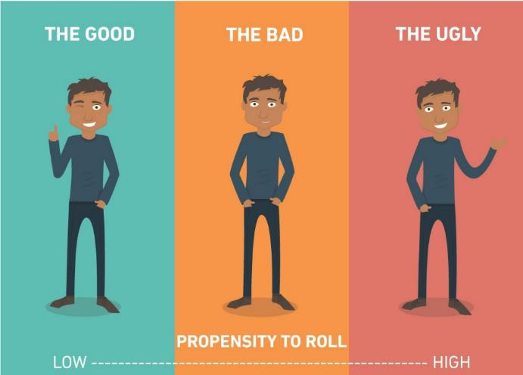
DEBTOR SEGMENTATION
Predict collection results and segment customers
Why can’t they pay?
How late will they pay in the upcoming cycle?
What actions have been working and how to maximize collection volume?
Notes:
A leading bank in Thailand has over 1M customers engaging in collection process each year.
They want to improve the bottom line performance: collecting more debt faster and take the best action to prevent non-performing loan.

Slide 34
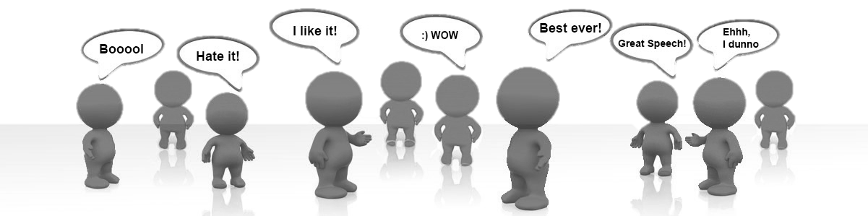
SENTIMENT ANALYSIS
To determine the sentiment with respect to some topic or the overall contextual polarity of a post/comment.
Widely applied to reviews and social media for marketing and customer service.

Slide 35
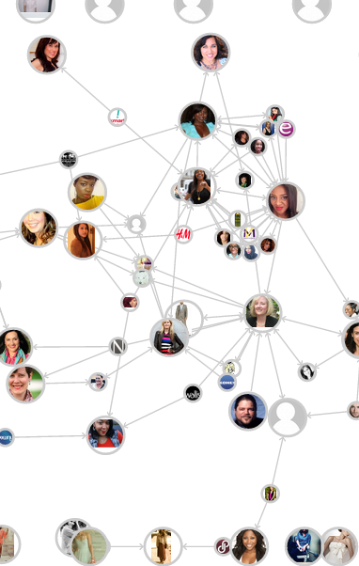
INFLUENCER ANALYSIS
An influencer is an individual who has above-average impact on a specific niche process.
On the social network, a influencer can referred to the most shaping a discussion about a brand or topic.

Slide 36

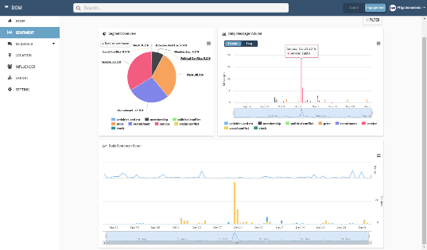
SOCIAL ANALYTIC TOOLS
#Keep track of your brand & competitors, #Real-time feed back monitoring, #Real-time anomaly detection, # Knows where your target , #Find out who influences your brand

Slide 37
INSIGHT THAT DRIVES DECISIONS
Return on campaigns
Stages on customer journey
Customer satisfaction
Effectiveness of campaigns
Customer loyalty
Sale volume
Return tendency
Promotion allocation
Optimal discount
Lead scoring
Usage analytics
Sensitivity to incentives
Acquisition rate
Attrition rate
Purchase timing
Campaign response
Repeat purchase
Favorite categories
Microsegments
Personas
Cohort analysis
Reactivation probability

Slide 38




The INITIATIVES

Slide 39
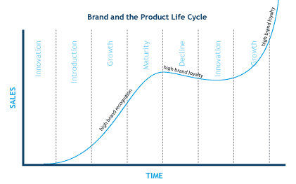
SALE FORCASTING FOR PLC PLAN
Predict short-term and long-term performance
Companies can base their forecasts on
Past sales data: sale trends over the last 5 years and factor analysis to see what impacts sales
Industry-wide comparisons
Economic trends.
Notes:
Sale forecast is about assumptions, expectations, drivers, tracking, and management.
You measure the value of a sales forecast like you do anything in business, by its measurable business results.
making clear assumptions and understanding what drives sales, such as
web traffic and conversions, in one example,
or the direct sales pipeline and leads, in another.
Review results every month, and revise your forecast. Your educated guesses become more accurate over time.
To forecast sales for a new mobile app, you might get data from the Apple and Android mobile app stores about average downloads for different apps. A good web search might also reveal some anecdotal evidence, blog posts, and news stories perhaps, about the ramp-up of existing apps that were successful.
Get those numbers and think about how your case might be different.

Slide 40
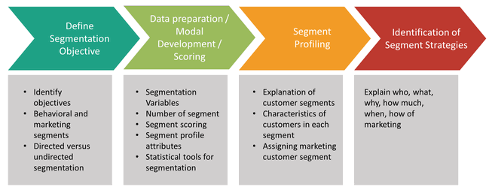

CUSTOMER SEGMENTATION
The better you understand, who are the customers at your store, the easier it is to tailor to your their needs.
WHAT you sell and HOW you sell it.

Slide 41

CAMPAIGN ANALYTICS
Tracking customer interactions (Google Analytics)
Linking marketing activities and conversions across systems
Linking social media marketing insights
Notes:
Google analytic can
Find out which online campaigns bring the most traffic and conversions.
Determine where your best visitors are located.
Learn what people are searching for on your site.
Visualize what people click on the most.
Uncover your top content.
Identify your worst performing pages.
Determine where people abandon the shopping cart.
Discover if you need a mobile site (How many visit from mobile devices)

Slide 42





THE KEY TAKEAWAY
Media and Things
Connectivity
Data
Analytics
Monitor, Alert,
Notify, Control Automate, Interact
People, Process, Assets, Environments
Connecting insights back to operations
Analytics is the process of capturing, interpreting and communicating useful information for better decision making

Slide 43

Get ready for the world of data

Slide 44
THE OBSTACLES
The absence of data and data gathering tools
Existing data quality (consistency, accuracy, completeness, conformity)
Lack of concept understanding in business problem formulation
Lack of data scientists / analysts
Data sharing within and across organizations
Maintainability after initiatives
Notes:
Kaggle for prototyping
Coursera for learning the concept and techniques

Slide 45

DATA, HOW TO OBTAIN MORE
Investment in mobile, AI, and conversational platforms
Investment in the use of IoTs
Create a seamless customer cross-channel experience
Explore social media sentiment and other unstructured data
Integrate data silos (Administration, CRM, billing, compliances, etc.)

Slide 46

BIG DATA SANDBOX
Sandbox allows an organization to realize its actual investment value in big data.
It is a developmental platform used to explore an organization's information sets.
Encourage collaboration and interaction
Encourage learning by doing
Build a data pool
Build or rent one ?

Slide 47


HR PREPERATION
HR should identify current and future human resources needs for an organization to become a data-driven one.
HR should come up with a plan to create
A new salary model for data scientist hiring
An incentive program and new opportunities for existing staffs
A multi-disciplinary task force

Slide 48



THE ROADMAP
VALUE
Understand big data
Ensure management buy-in
Create a multi-disciplinary team
Define a list of use cases
Explore Data Landscape
Select proof of concepts
Collect data
Create use case prototypes
Share the results
Define the ROI
Invest in infrastructure
Expand the team and start implementation
Organization wide training
Improve overall organization
Solution Architecture Design (Vendor)
Initial Investment on Infrastructure (rent)

Slide 49


Facebook.com / BigDataExperience
CONTACT
08 9789 5224, 09 8258 8261
contact@BigDataExperience.org
JOIN
www.BigDataExperience.org / join
MEET
www.BigDataExperience.org / request

Slide 50


A market place where everyone is exchanging idea and practice around Big data technology; to create a practical realization of Big data in Thailand
Fostering the Industry-University collaboration and innovation

Slide 51



BX KEY ACTIVITIES
EXPLAIN EXPLORE EXCHANGE
Facilitate the acquisition of knowledge related to Big Data technologies and analytics through teaching, training, and discussion
ACTIVITIES
#Talks #Workshop
#Work Integrated Learning
#Internship #BX Workshop
#Short-course on big data
Help members investigate the data landscape in their organizations and build early samples of model to analyze data for business insights
ACTIVITIES
#Model-prototyping
#Case-studies
#Strategic planning
#Consultation
Bring together researchers, technology providers, and users to exchange ideas, evidences, and expertises with mission to build a community of practice
ACTIVITIES
#Seminars
#Idea-competitions
#Networking-events

